Slide 1

Oracle Estate Explorer Explore Your Database Estate, build a Business Case and optimize your Cloud Migration
Overview

Slide 2
Oracle Estate Explorer enables you to …
Understand their current Database Estate
Plan a hybrid, multi-cloud migration strategy
Build a complete database inventory
Visualize any size database estate
Analyze in technical & business context
Build a Business Case with on-prem and cloud TCO
Prioritize database migrations to any cloud database
Optimize the migration deployment
Any source - Any target

Slide 3
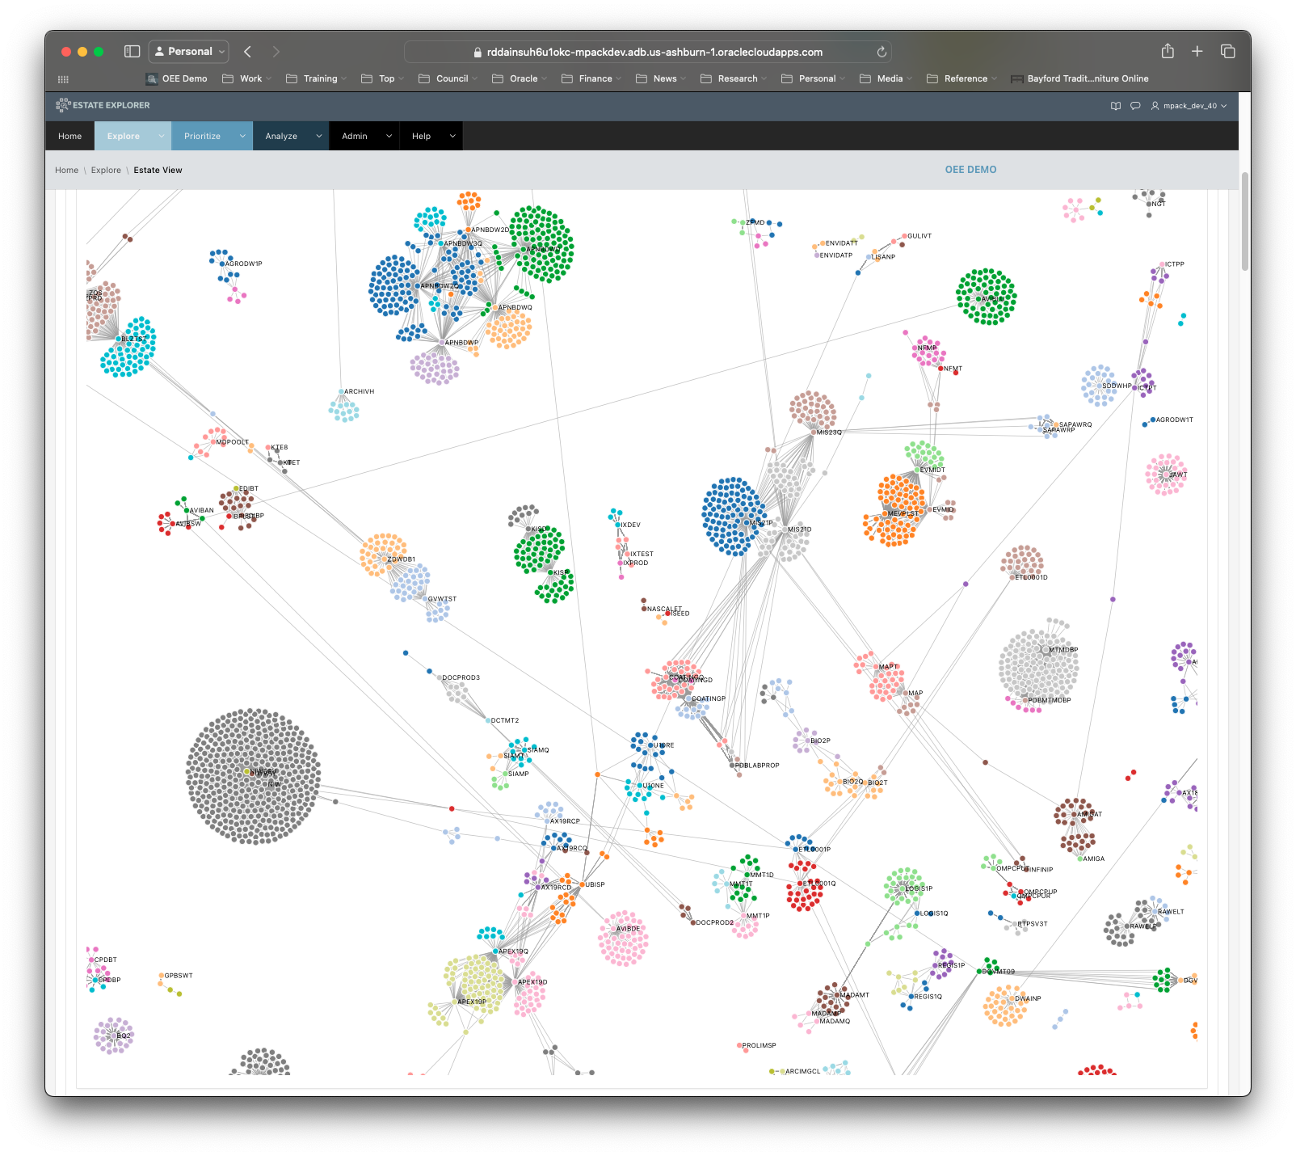

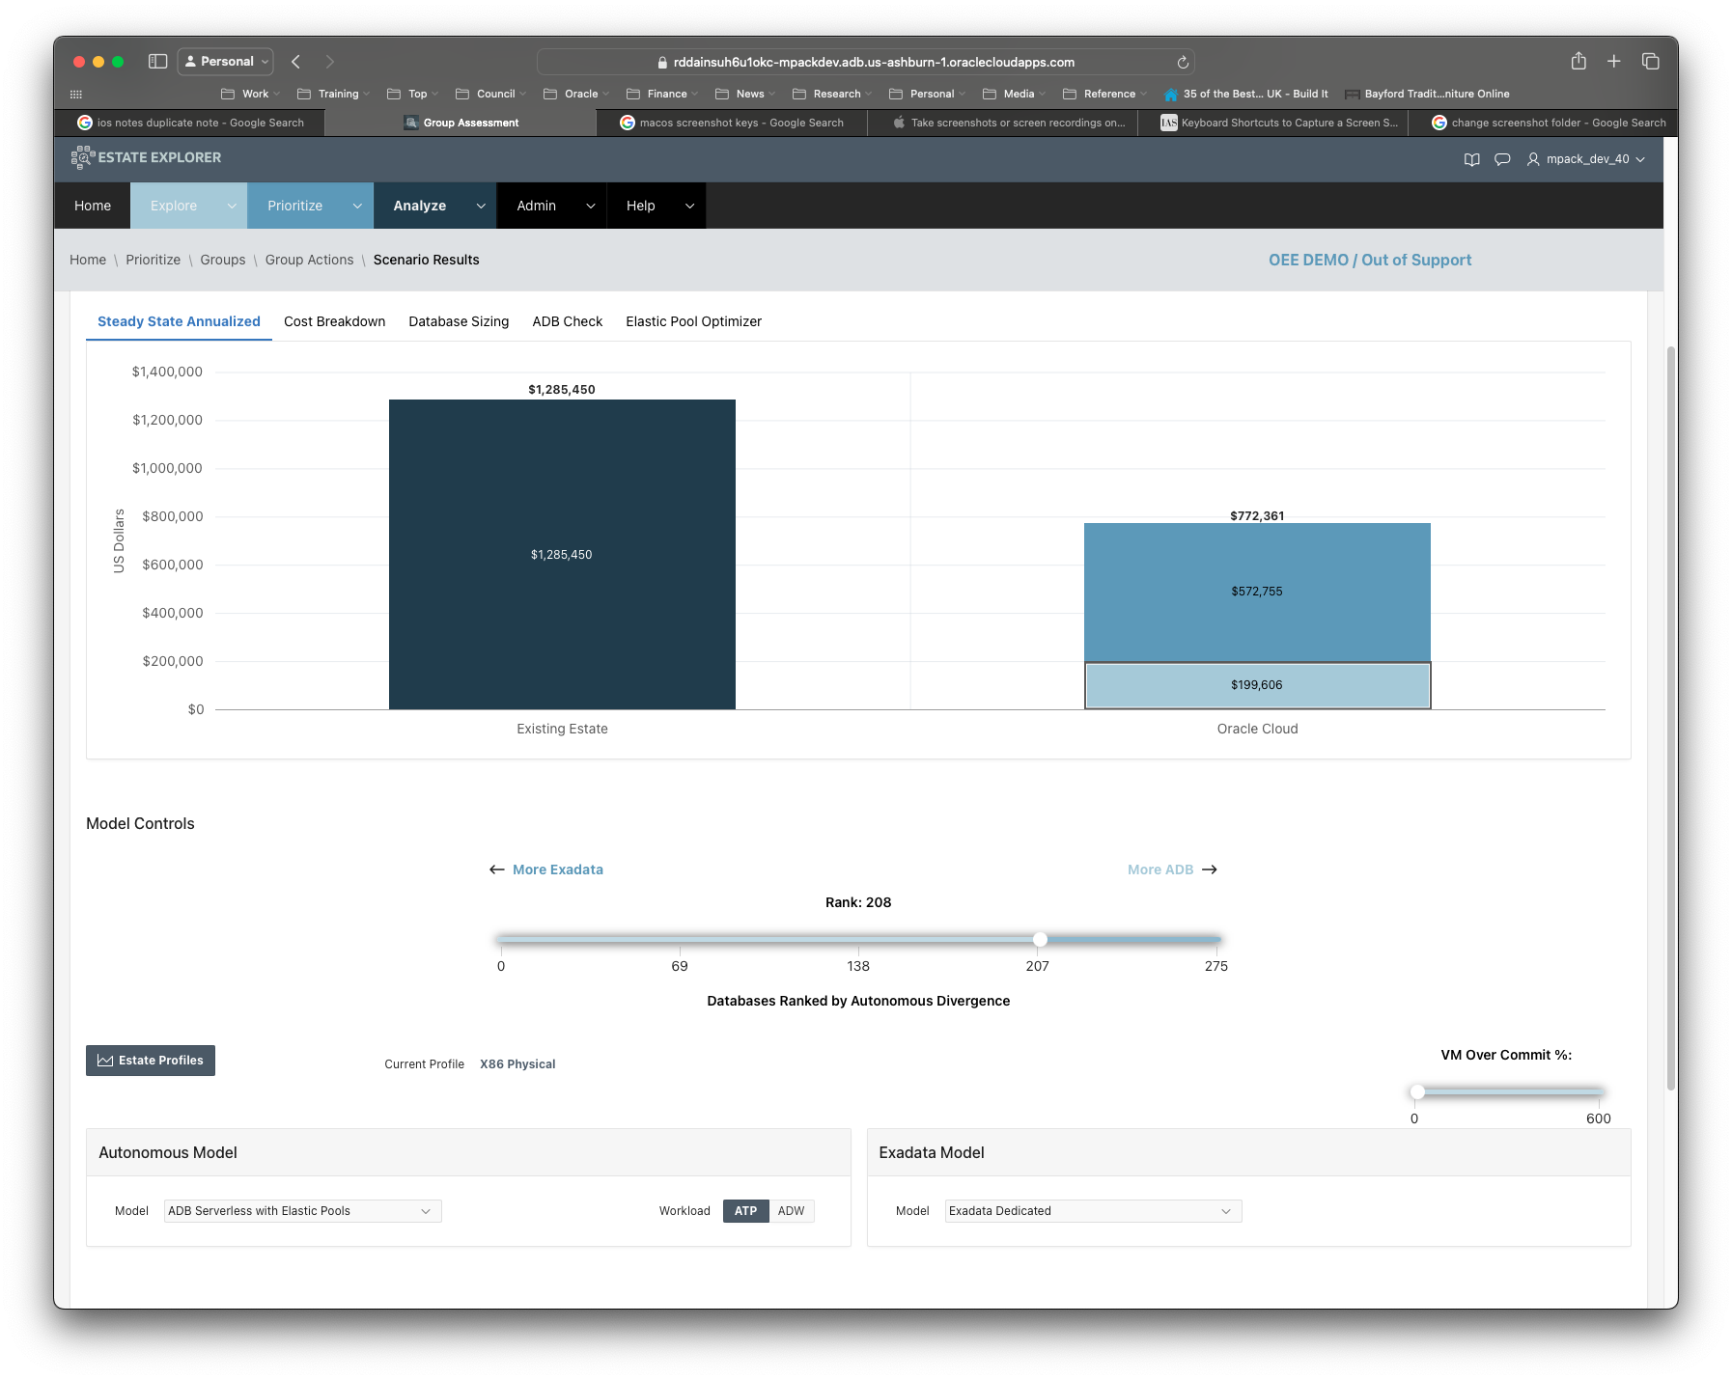

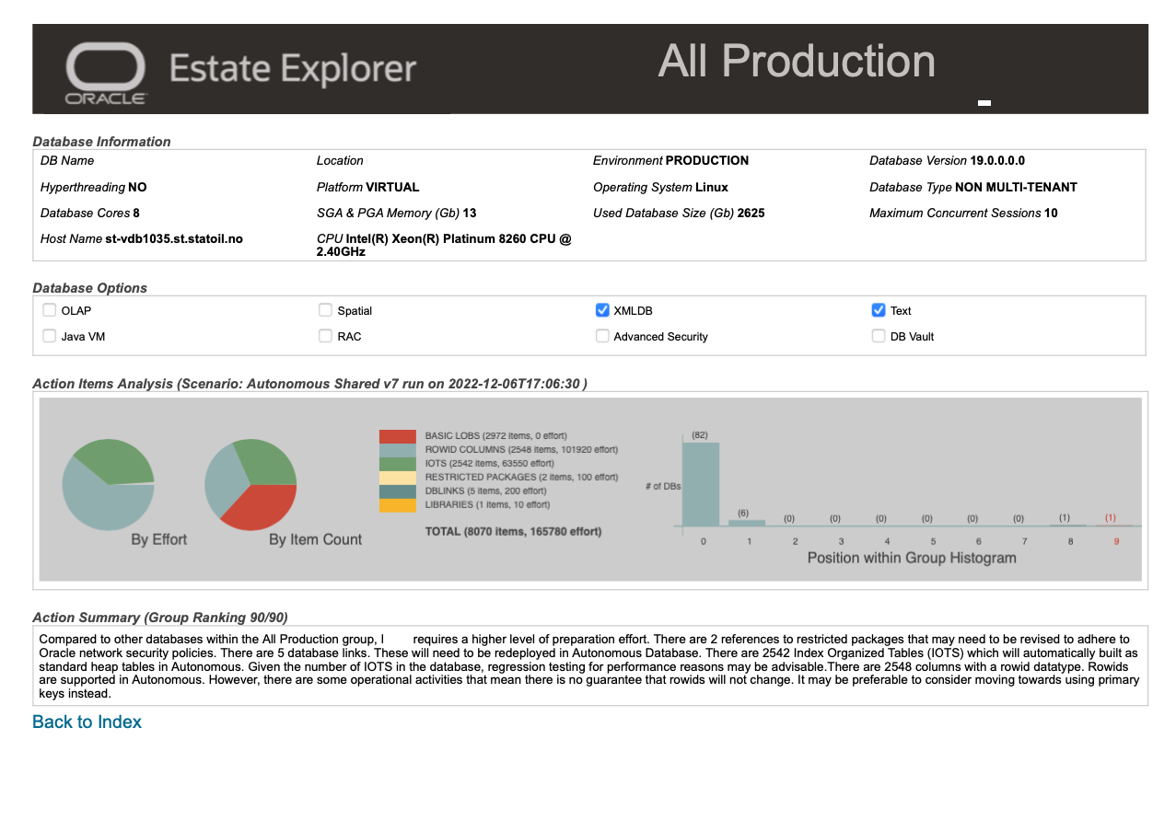

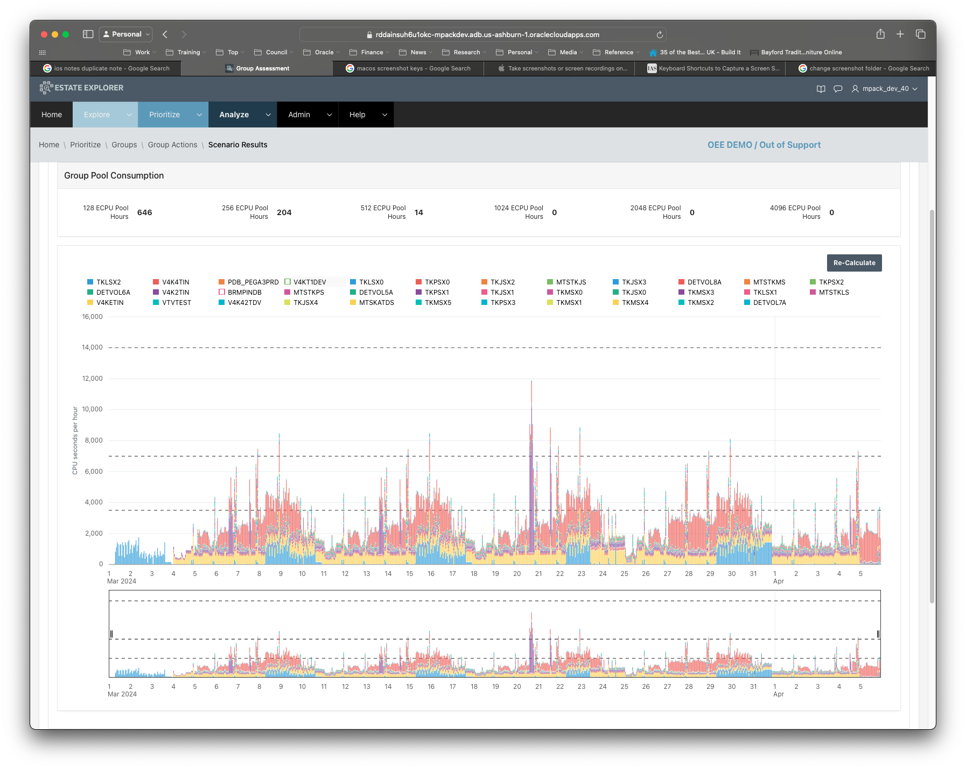

Oracle Estate Explorer
Analyze 1000’s of databases in just a few hours
View innovative visualizations of a database estate
Provide a detailed TCO to compare on-premises and cloud
Prioritize migrations by ADB readiness
Optimize ADB deployments with Elastic Pool Consolidation

Slide 4






Oracle Estate Explorer
Key Features
Data privacy
no need to share data with Oracle
Deploy anywhere
in public cloud, on-premises, or even on a laptop
Ultra-light footprint
minimal install requirements and a light touch on databases
Code transparency
for customers and partners
Customizable model
build a custom estimation model for your organization

Slide 5
Engage with us in different ways …
Independent
Deploy Oracle Estate Explorer yourself within your own on-premises, OCI, or 3rd party cloud environment.
Perform all aspects of data gathering and analysis independently of Oracle.
Collaborative
With Oracle guidance, deploy Oracle Estate Explorer within your own on-premises, OCI, or 3rd party cloud environment.
Oracle works with you to perform data extracts, analysis and reporting.
Service
Oracle hosts the Oracle Estate Explorer instance.
You run the extracts and send the output to Oracle.
Oracle delivers back a full report and provides detailed guidance

Slide 6
Oracle Estate Explorer
Features, Functions and Process

Slide 7
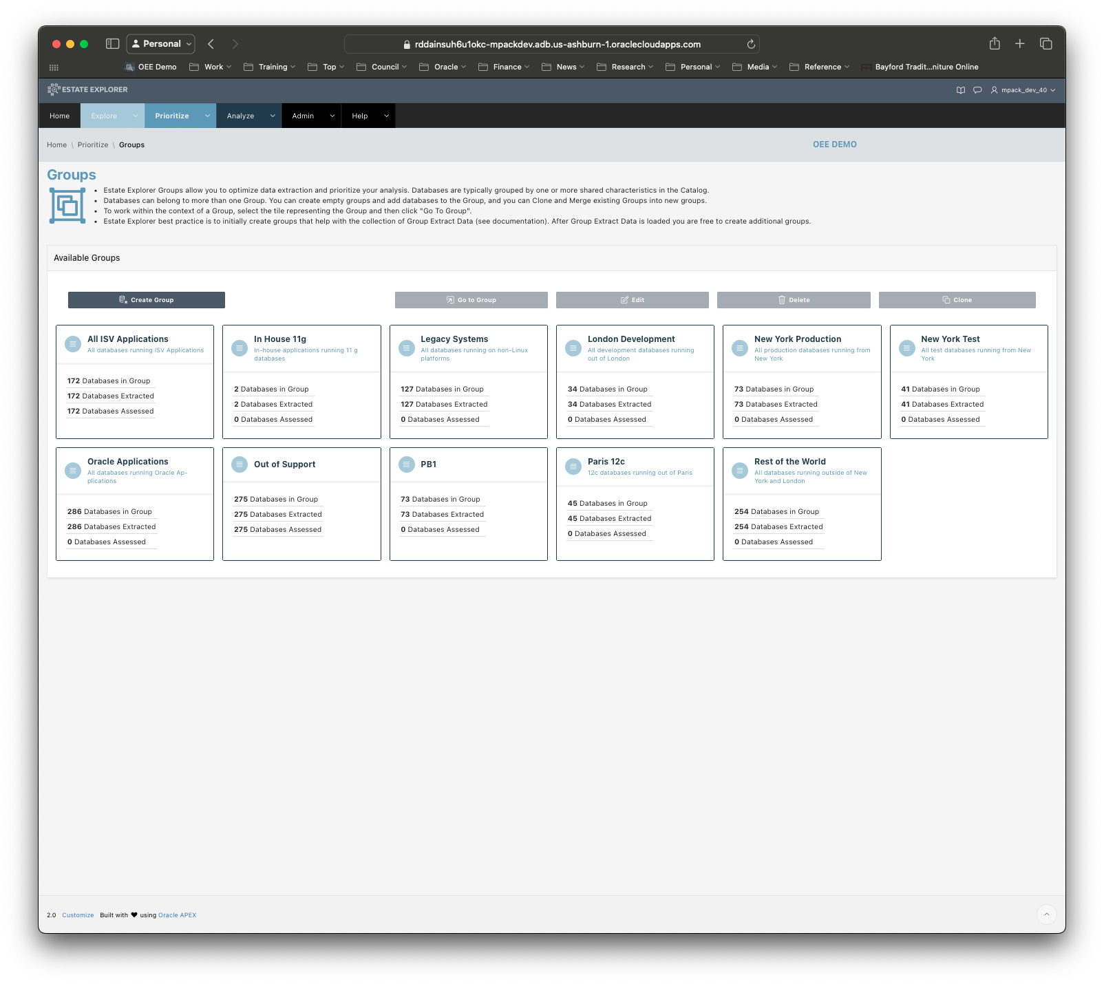
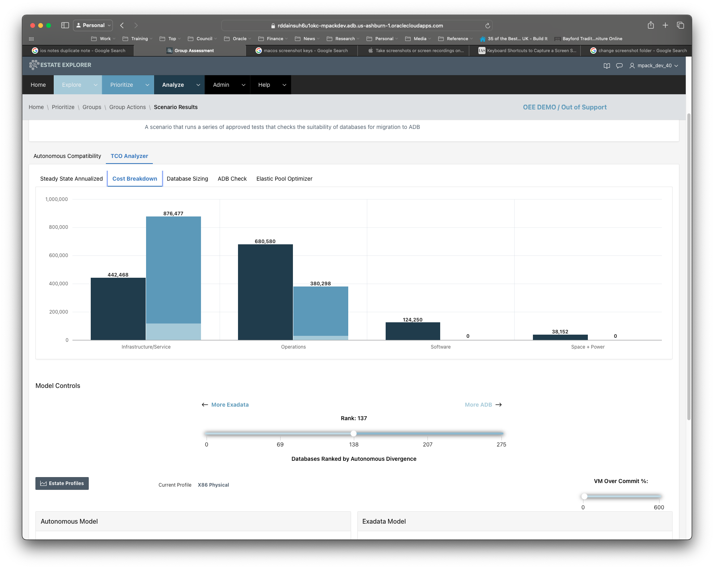
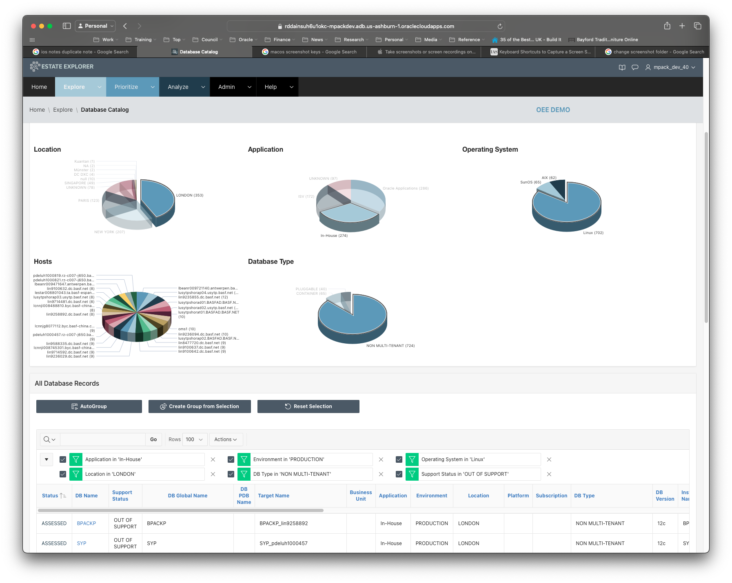
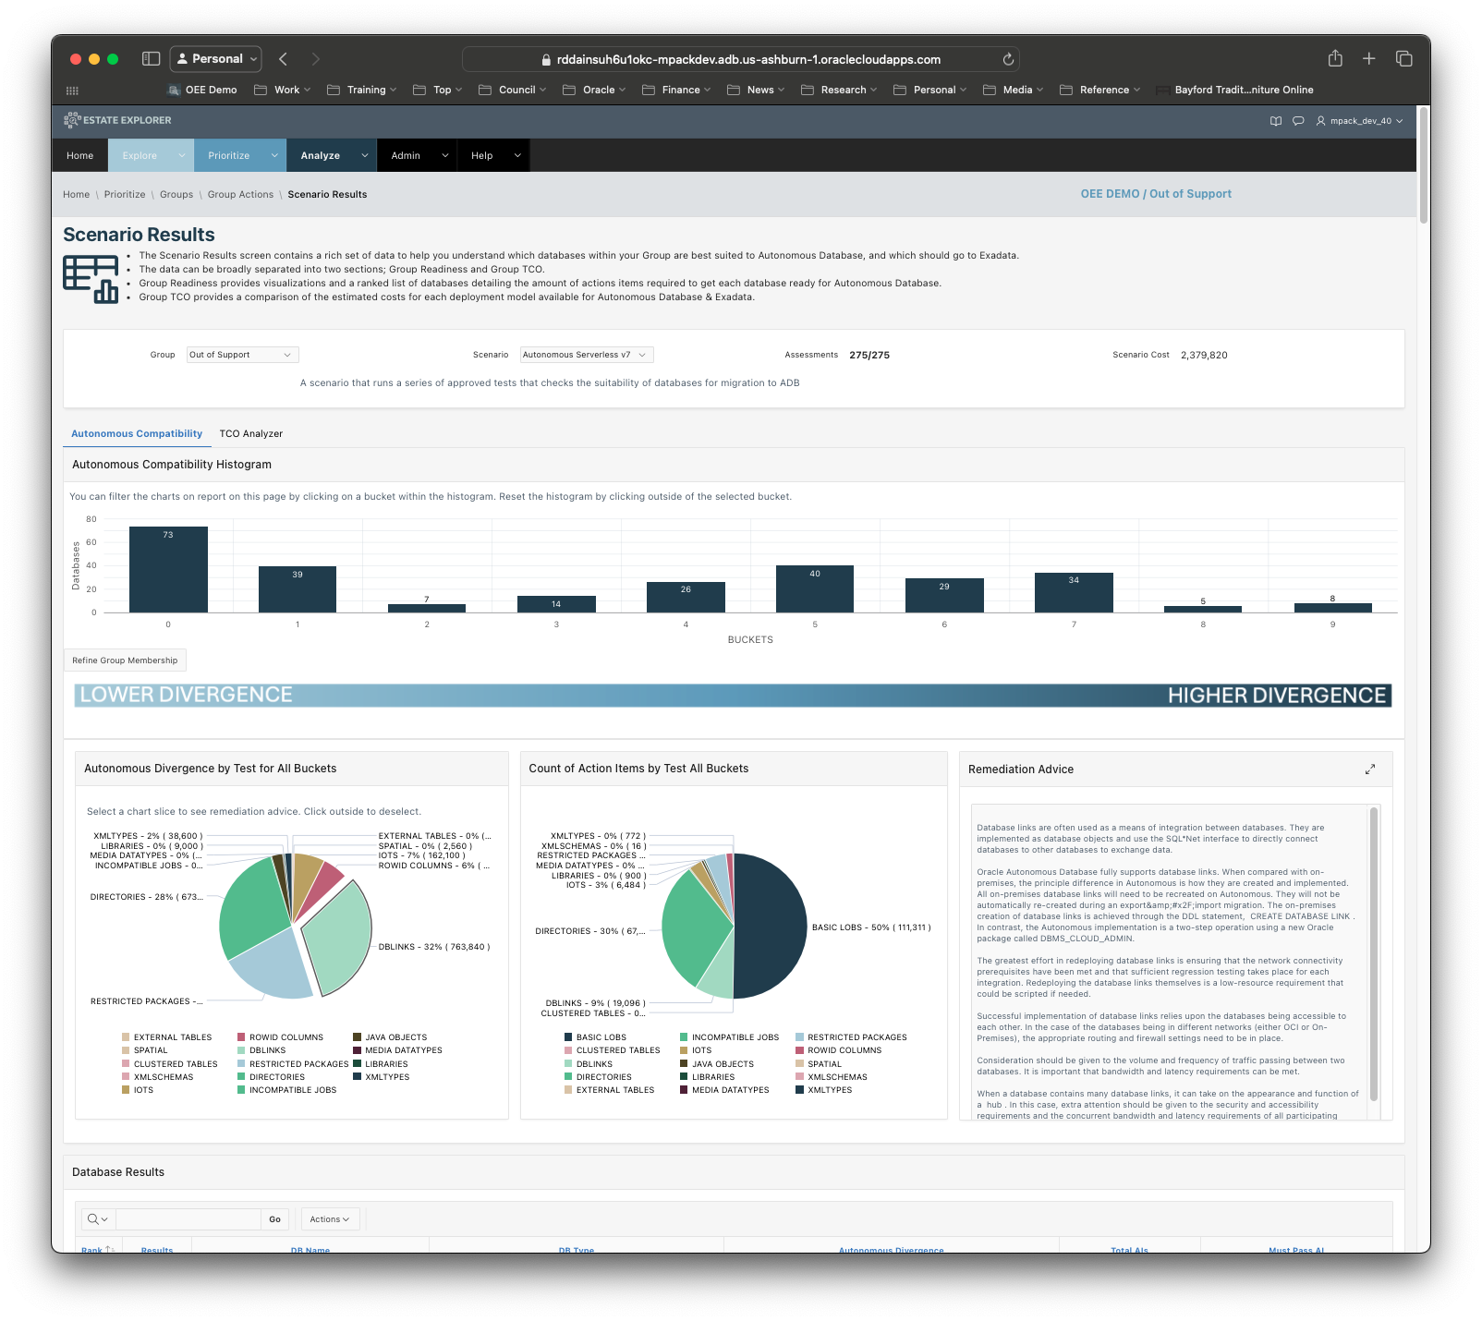
Oracle Estate Explorer – Key Steps
Prioritize Database Migrations
Analyze Database Estate
Explore an Estate Catalog
Build Groups
Build TCO
Database Details
Database Links
Assess DBs
Build Elastic Pools

Slide 8
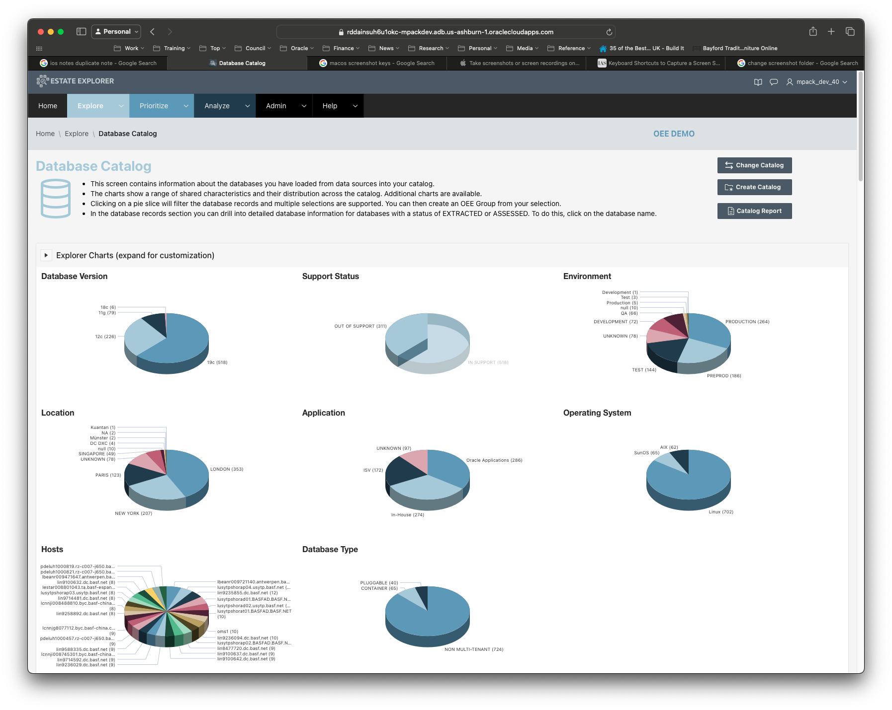
Estate Summary View
View your databases by your technical and business criteria
Define criteria based on your naming standards
By geography, business unit, platform, etc
By database version, host OS, #cores etc
Define new subsets of databases for analysis

Slide 9
Estate Cluster View
View a group of databases by their connections
Based on database links between databases
Identify groups of linked databases
Generate lists of clusters of databases
Create linked groups for further analysis

Slide 10
TCO Analyzer – Compare current with future
Run-time TCO
Built from actual database information
TCO model aligned with Business Value Team
Compare on-prem, or other cloud with OCI
Supports C@C and OCI as targets
Flexibly split workloads between Exa and ADB

Slide 11
Database Estate Assessment for Autonomous Database
Migration preparation & effort
Aggregate view
Drill down to individual databases
Detailed actions at an object level
Customizable effort values
View by count of objects or estimated effort

Slide 12
ADB Elastic Pools Simulator
Migration preparation & effort
Based on actual CPU usage from AWR for one month
Missing days and time intelligently interpolated
Maps against Elastic Pool size and auto pool size
Manual selection of databases to include/exclude
Zoom into any time period for fine tuning

Slide 13
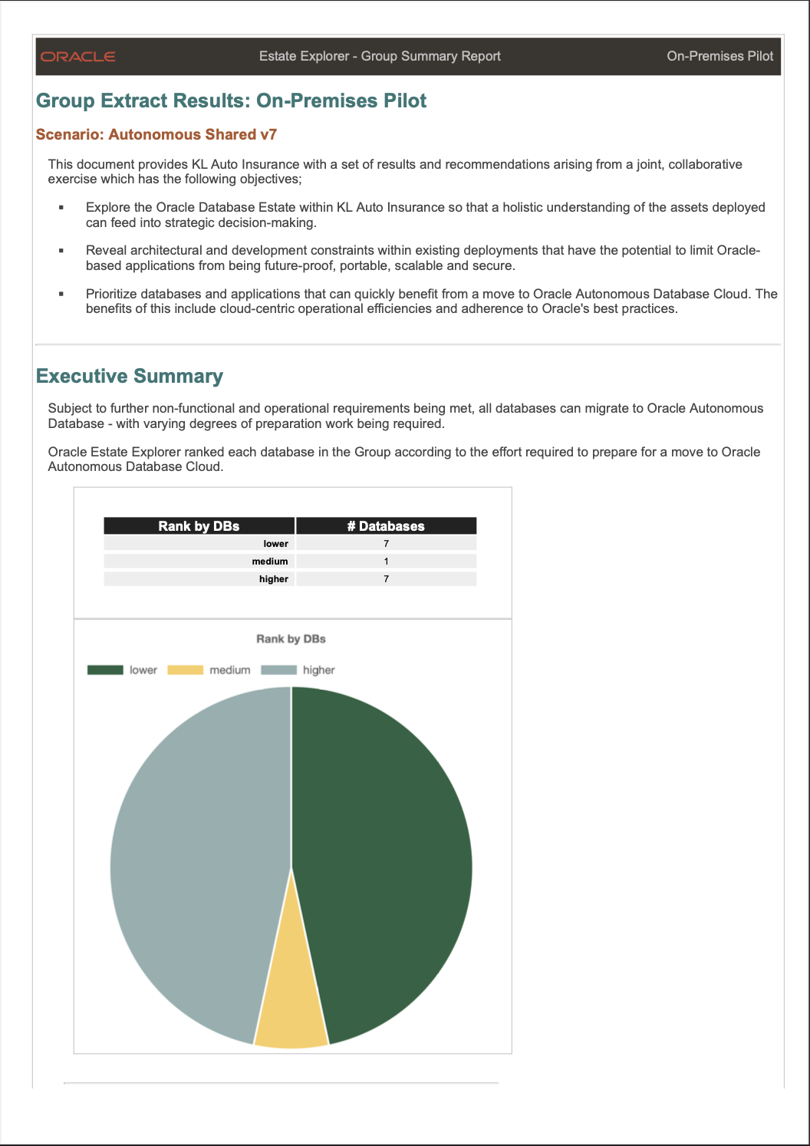
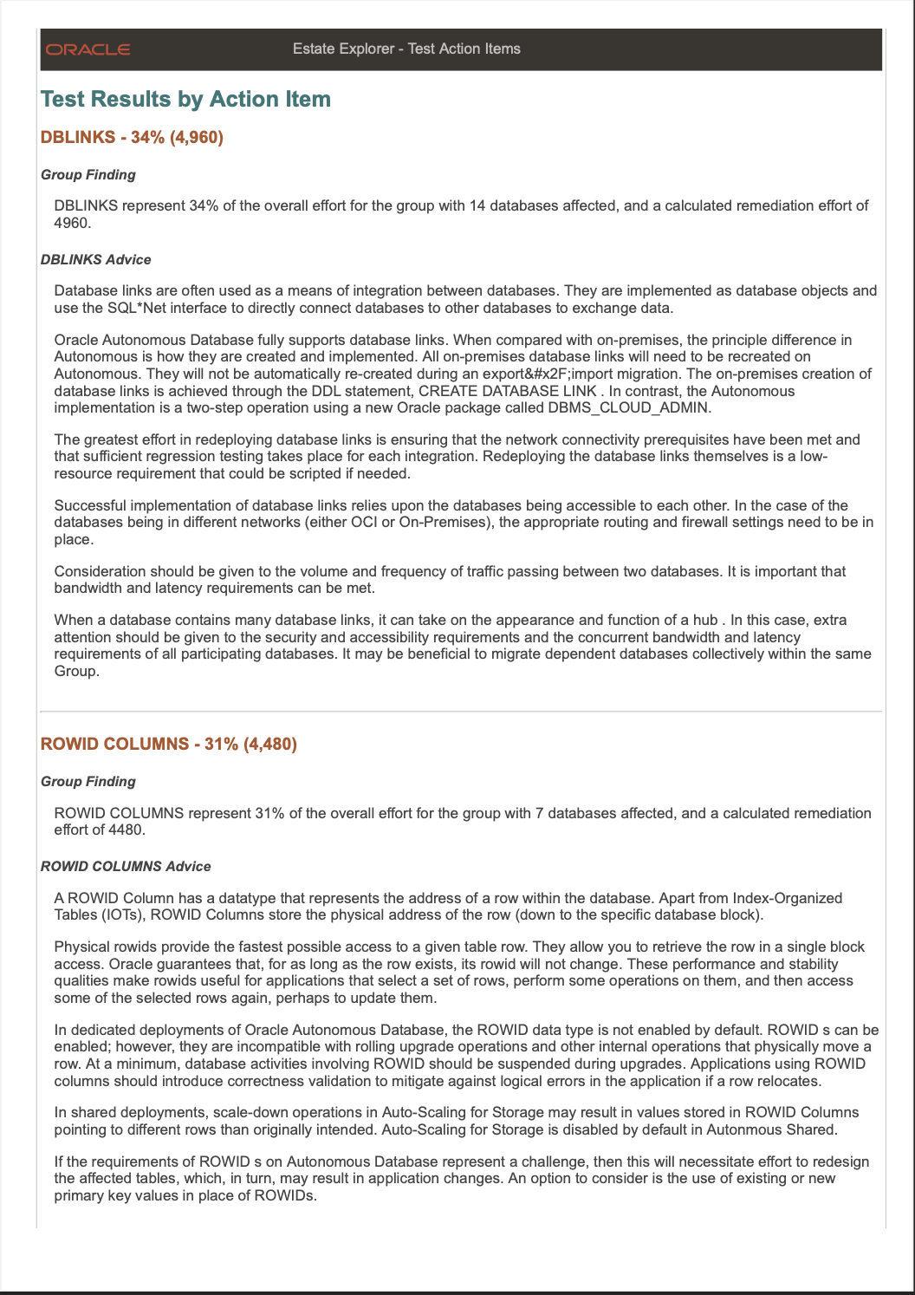
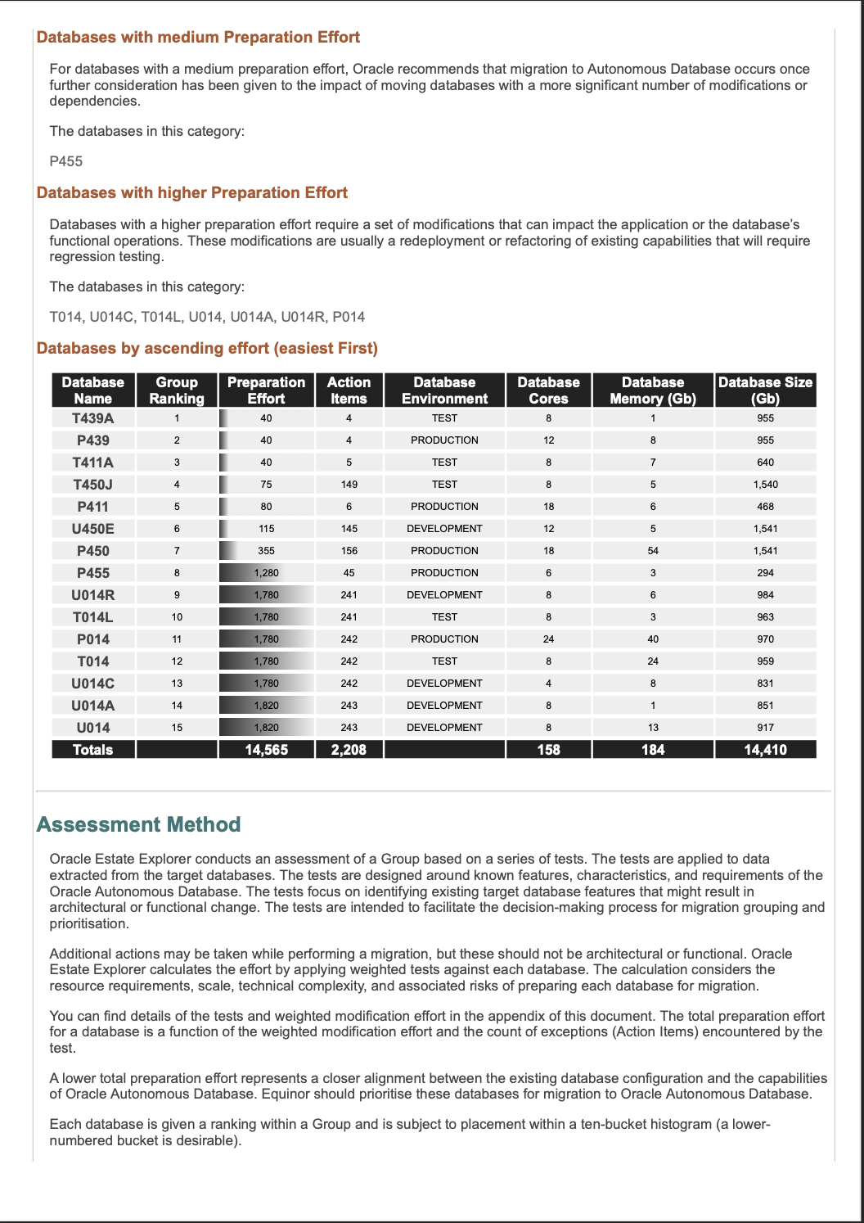
Auto-generate PDF Reports
A complete view of your database estate
key estate facts and findings
a league table with ranking of every database
recommendations on categorization & prioritization
remediation steps for each database at object level
Share as PDF
generated in seconds without human intervention
share easily across your organization in PDF

Slide 14
Demo

Slide 15





Where can I deploy the OEE Application ?
Requirements
Deployment Options
Oracle Database 19c
In a VM
Autonomous Database
APEX & ORDS
On-Premises
Any Cloud
The APEX application is self-contained and ultra-lightweight with no external dependencies
Deploy the APEX application wherever you need it – full installation scripts are provided

Slide 16
Oracle Estate Explorer
Internal
Where to find out more
Oracle Estate Explorer
https://www.oracle.com/database/cloud-migration/estate-explorer/
OEE Home Page (Internal)
https://mysites.oracle.com/estate-explorer/
Downloads (internal)
https://mysites.oracle.com/estate-explorer/downloads.html
Estate Explorer FAQ
https://mysites.oracle.com/estate-explorer/faq.html

Slide 17
Any Questions ?

